Slide 1
Can Wikipedia Page Activity be Used to Predict Box Office Revenue?
MadR meeting
May 2014

Slide 2
Why bother?
$10b in revenue in US
Lone Ranger (2013)
Approx. $250m to make
Approx. $260m in revenue worldwide
Slumdog Millionaire (2008)
Approx. $15m to make
Approx. $280m in revenue worldwide

Slide 3
Other things to consider
Advertising
Rating
Genre
Studio
Number of theaters

Slide 4

Why Wikipedia?
Our project was inspired by Mestyan et al. (PLoS ONE 8(8): e71226)

Slide 5
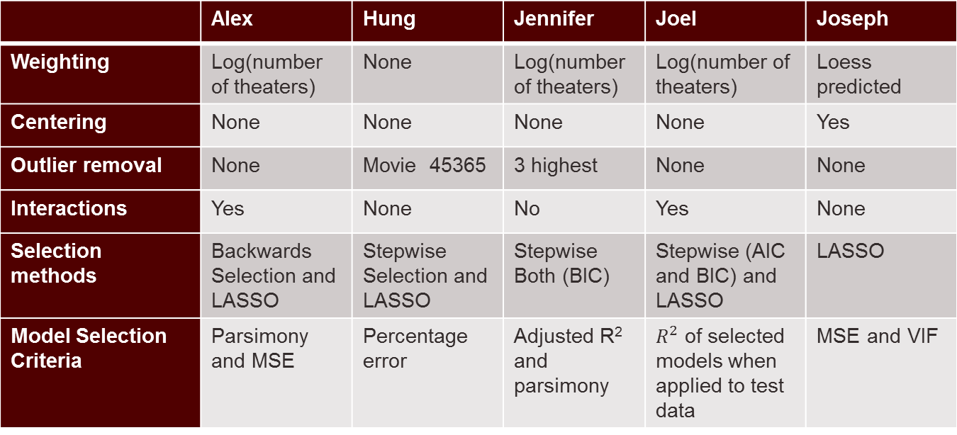
A team effort
 | Alex | Hung | Jennifer | Joel | Joseph
Weighting | Log(number of theaters) | None | Log(number of theaters) | Log(number of theaters) | Loess predicted
Centering | None | None | None | None | Yes
Outlier removal | None | Movie 45365 | 3 highest | None | None
Interactions | Yes | None | No | Yes | None
Selection methods | Backwards Selection and LASSO | Stepwise Selection and LASSO | Stepwise Both (BIC) | Stepwise (AIC and BIC) and LASSO | LASSO
Model Selection Criteria | Parsimony and MSE | Percentage error | Adjusted R² and parsimony | $R^{2}$ of selected models when applied to test data | MSE and VIF

Slide 6
Goals
Construct a model that can predict opening weekend box office revenue that:
Incorporates Wikipedia page view and edit data
Provides a prediction as early as possible
Is parsimonious

Slide 7
Response Variable
Opening weekend box office totals in US Dollars for 310 movies released in 2010.
Source: boxofficemojo.com
Log transformation due to large range
Minimum: $107 (sic)
Maximum: $128 million
Notes:
Add plots of response variable

Slide 8
Variables in the PLoS data set
Number of Theaters
Date of Release
Inception – number of days prior to release that a movie’s article was created
No_Article – equal to 1 if a movie’s Wikipedia article was created after release and 0 otherwise

Slide 9
Variables in the PLoS data set
Views* – number of times a movie’s Wikipedia article was viewed. For movies lacking an article, the number of times that movie’s title was searched in Wikipedia.
Users* – number of users who edited a movie’s article
* Recorded at 60, 50, 40, 30, 20, and 10 days prior to release.

Slide 10
Variables in the PLoS data set
Edits* – the number of times a movie’s article was edited
Rigor* – number of edits corrected for successive edits by the same user
* Recorded at 60, 50, 40, 30, 20, and 10 days prior to release.

Slide 11
Other variables considered
Wide_Release – equal to 1 if a movie was screened at more than 1300 theaters
Is_sequel – equal to 1 if a movie is a sequel
Is_3D_or_IMAX – equal to 1 if a movie was released in 3D or IMAX format
Fri_Sat – equal to 1 if a movie was released on Friday or Saturday

Slide 12
Other variables considered
In_Summer – indicator variable for whether a movie was released between Memorial Day and Labor Day
Federal_Holiday – equal to 1 if the movie was released on the weekend containing the 4th of July or Christmas
N_Other_Rel – number of other movies released on the same weekend

Slide 13
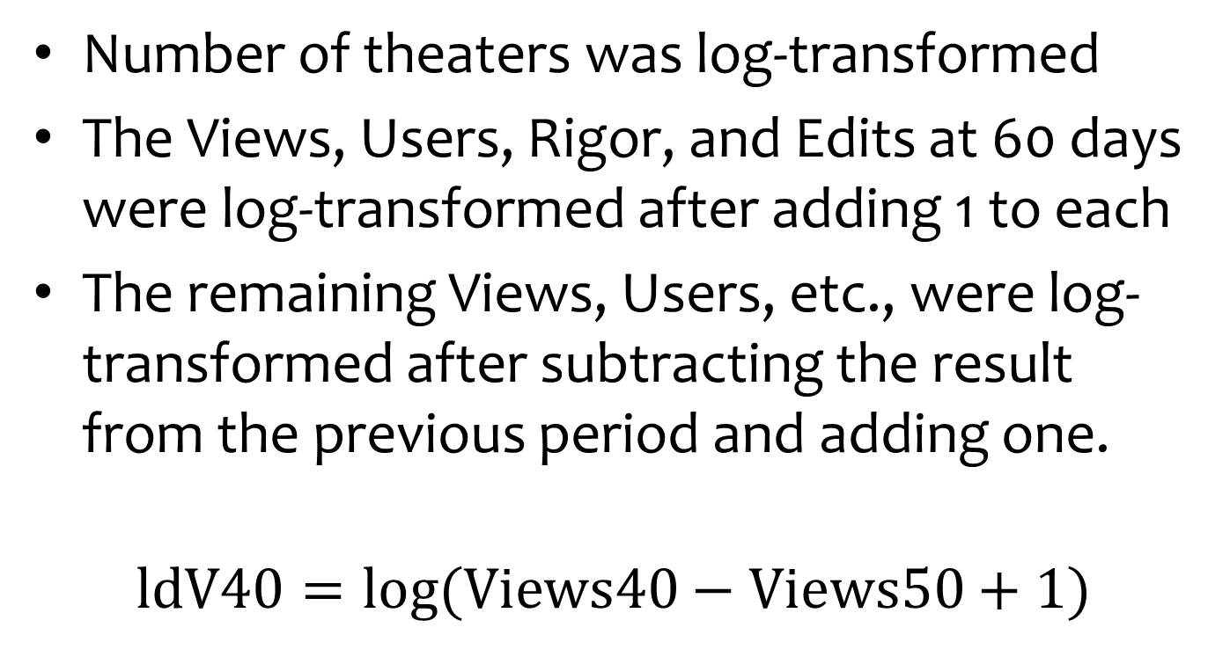
Transformation of predictor variables
Number of theaters was log-transformed
The Views, Users, Rigor, and Edits at 60 days were log-transformed after adding 1 to each
The remaining Views, Users, etc., were log-transformed after subtracting the result from the previous period and adding one.
$$\text{ldV}\text{40}=log⁡(\text{Views}\text{40}−\text{Views}\text{50}+1)$$
Notes:
Find pictures of each after transformation

Slide 14
Training and test data sets
Sixty percent of the data were assigned to a training set. The remaining data were held back for model validation.
To help ensure that the two sets were similar, the movies were sorted by revenue and divided into groups of five. For each group, three were randomly assigned to the training set and the remaining two were assigned to the test set.

Slide 15
Where I used R
Almost everywhere:
Data cleaning and transformation
Initial models
Variable selection
Creation of final visualizations
Where I didn’t:
Initial exploration of the data (JMP)
Progress reports and slides for final presentation (Office)

Slide 16
Using the ggplot2 package for exploratory data analysis

Slide 17
Pros and cons of ggplot
It’s essentially a new language (keep in mind what it’s named after!)
Steep learning curve
Need to practice
It’s elegant
There’s tons of help on the Internet.

Slide 18

Creating plots with ggplot
Create a data frame
Assign aesthetics
Add geom’s

Slide 19
Creating and assessing regression models in R

Slide 20

It’s as easy as 1-2-3!
Create a data frame
Pass it and a formula to lm()
Evaluate the resulting object using summary() and plot()
Repeat as necessary.

Slide 21
Using the glmnet package to perform variable selection

Slide 22

What is LASSO?
Minimizes the sum of squares, but with a penalty on the size of the coefficients
Penalty is chosen by a tuning parameter $λ$, which is chosen by cross-validation.

Slide 23
Variable selection
Six sets of models were generated – one for each period in which Wikipedia article data was collected. For each period, only terms available within that period were used.
Two methods employed:
stepwise
LASSO

Slide 24
Models chosen by stepwise
R-squared values obtained from fitting the selected models on the test data

Slide 25
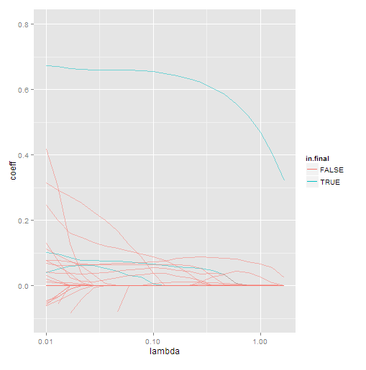
Comparison of stepwise and LASSO shrinkage
Blue lines: selected by stepwise
Red lines: eliminated by stepwise
Two very different models are selected by the two methods
A very large penalty needed for LASSO to get similarly sized models

Slide 26
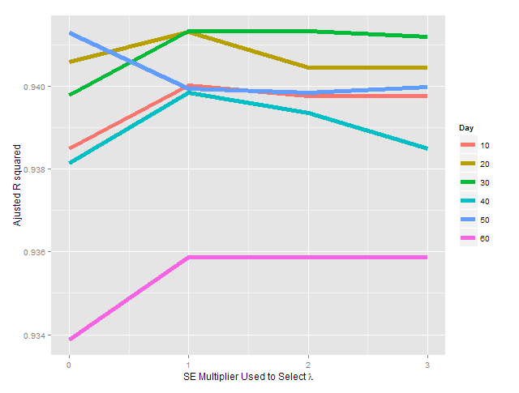
Relative performance of LASSO models by day

Slide 27
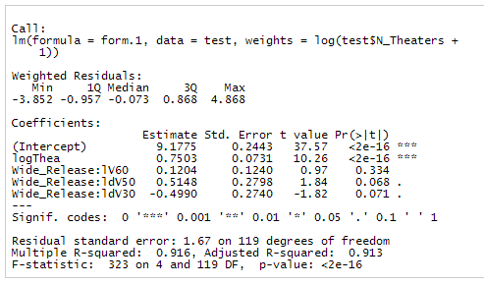
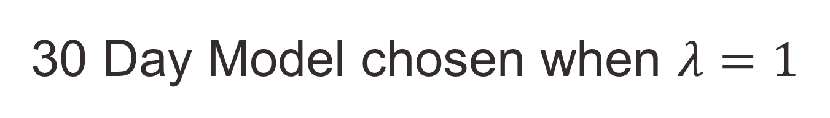
30 Day Model chosen when $λ=1$
LASSO
BIC

Slide 28
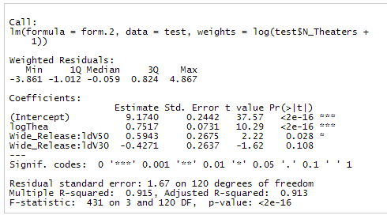

30 Day Model chosen when $λ=2$
LASSO
BIC

Slide 29
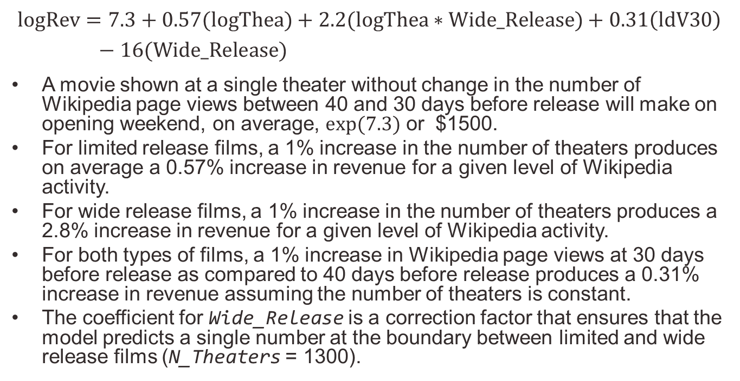
Final model and interpretation
$$\text{logRev}=7.3+0.57\text{(}\text{logThea}\text{)}+2.2(\text{logThea}∗\text{Wide}\text{_}\text{Release})+0.31\left(\text{ldV}\text{30}\right)−16(\text{Wide}\text{_}\text{Release}\text{)}$$
A movie shown at a single theater without change in the number of Wikipedia page views between 40 and 30 days before release will make on opening weekend, on average, $exp⁡(7.3)$ or $1500.
For limited release films, a 1% increase in the number of theaters produces on average a 0.57% increase in revenue for a given level of Wikipedia activity.
For wide release films, a 1% increase in the number of theaters produces a 2.8% increase in revenue for a given level of Wikipedia activity.
For both types of films, a 1% increase in Wikipedia page views at 30 days before release as compared to 40 days before release produces a 0.31% increase in revenue assuming the number of theaters is constant.
The coefficient for Wide_Release is a correction factor that ensures that the model predicts a single number at the boundary between limited and wide release films (N_Theaters = 1300).

Slide 30
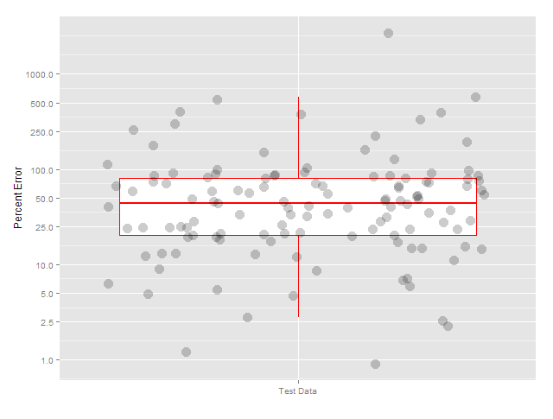

Model performance
Range is approximately 1-2000%.
However, half the errors lie between 25 and 100%
$$\text{Percent} \text{error}=\frac{\text{actual}\text{ [\$]}−\text{predicted}\text{ [\$]}}{\text{actual}\text{ [\$]}}×100\%$$

Slide 31
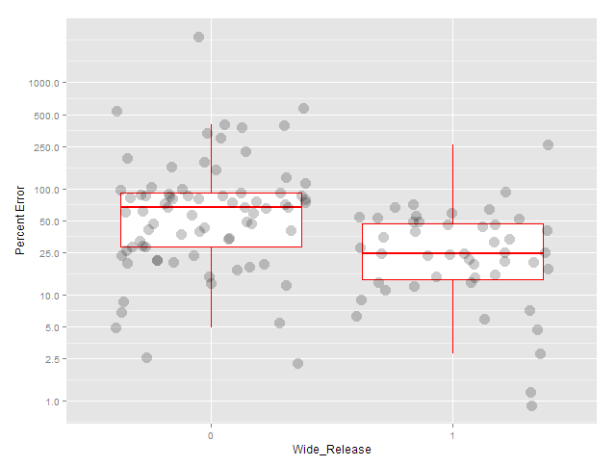
Model performance
Errors are smaller for wide release films (half lie between 20 and 50%).
Revenue for limited release films is much harder to estimate (half lie between 25 and 100%).

Slide 32
Acknowledgments
Alex Bessinger, Jennifer Morse, Hung Tran, Joseph Magagnoli
Profs. Simon Sheather, Alan Dabney, Don Allen
Jennifer South, Kim Ritchie, Penny Jackson

